Slide 1
The Indian Child Welfare Act (ICWA) and its Impact on Family Law Cases in Colorado
Presented by Magistrate Michelle Haynes, 2nd JD and Lisa Shellenberger, Setter Roche Smith and Shellenberger, LLP

Slide 2
What will we cover today?
What is ICWA?
CO Judicial Branch ICWA Toolkit - forms, bench cards, cases, law, ICWA guidelines
Inquiry and Notice
Advising on past ICWA findings and involvement of non-parents
ICWA Requirements and Strategic Approaches in DR
QEWs
Required Findings

Slide 3
ICWA History
What is ICWA? The Indian Child Welfare Act (ICWA) is a federal law passed in 1978 “… to protect the best interests of Indian children and to promote the stability and security of Indian tribes and families by the establishment of minimum Federal standards for the removal of Indian children from their families and the placement of such children in foster or adoptive homes which will reflect the unique values of Indian culture….” 25 U.S.C.§1902.
Before ICWA, was common for native children to be removed from their families and placed into foster care or with non-native parents. ICWA grants tribes concurrent jurisdiction with state courts over Indian children living off the reservation.
ICWA applies when the proceedings are child custody proceedings as defined under 25 U.S.C. § 1903(1); and the child is an “Indian child” as the ICWA defines that term under 25 U.S.C. § 1903(4).
This includes any action involving orders for a non-biological parent(s) in a child custody proceeding including D&N, APR, divorce, guardianships for minor children, and adoption proceedings.

Slide 4
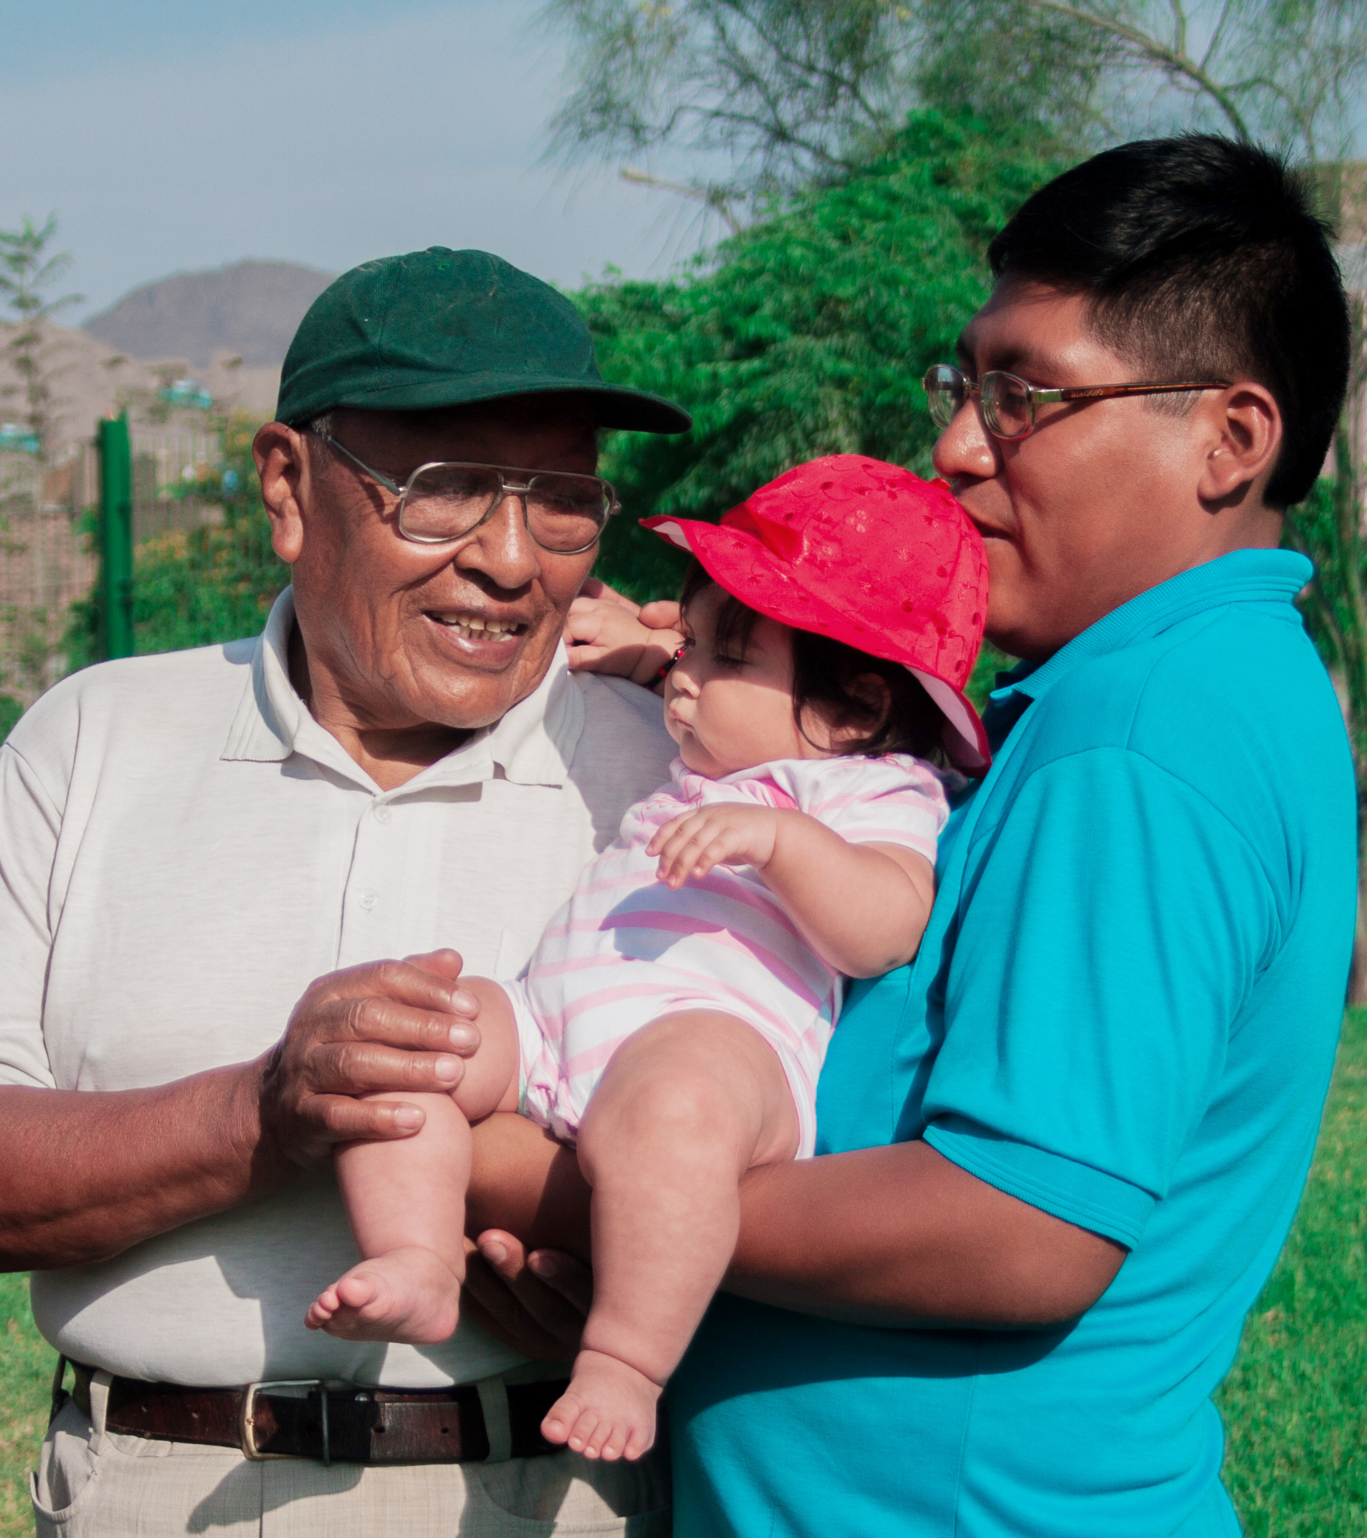
ICWA Summary
“Child custody proceeding” involving non-biological parent
Child is member or potential member of Indian Tribe
Inquiry
Notice
Determination – ICWA founded or not founded
Right to Court Appointed Counsel
Tribe’s Right to Intervene & Potential Transfer
Active Efforts Requirement
Placement Preferences
QEW Testimony
Appropriate Findings and Orders

Slide 5
ICWA Applies When:
“Child custody proceeding” as defined under 25 U.S.C. § 1903(1) - any DR action (APR or DOM) involving request for parenting time with a non-biological parent(s) 25 U.S.C.§1903(1); In re Marriage of Stockwell, 446, P.3d 957 (Colo. App. 2019)
and
Child is an “Indian child” as defined in ICWA 25 U.S.C. § 1903(4).
Unmarried, under age of 18, and is either:
Member or citizen of an Indian tribe; or
Eligible for membership or citizenship in an Indian Tribe and is the biological child of a member/citizen of an Indian tribe. 25 U.S.C.§ 1903(4).

Slide 6
ICWA Resources
ICWA has been addressed in our JV courts for a long time, but has been addressed less consistently in other case types (DR, PR, adoption).
In 2019, following Stockwell, ICWA workgroup developed some materials for use primarily by the court.
Includes bench cards, ICWA statute, ICWA guidelines, case law, example notices, proposed orders, etc.
Other Resources:
Denver ICWA Court - Juvenile Court has a dedicated ICWA docket - Judge Pax Moultrie, formerly Judge Donna Schmalberger
Denver Probate Court – Magistrate Beth Tomerlin and Judge Elizabeth Leith
Adams ICWA Court – Judge Katherine Delgado, Deputy Court Executive Simone Jones, Judge Edward Moss (Ret.)
DIFRC – Denver Indian Family Resource Center
Denver Indian Center
Casey Family Programs – Indian Child Welfare Programs Office
DENVER INDIAN HEALTH AND FAMILY SERVICES

Slide 7
Inquiry
Court should ask each party on the record whether the participant knows or has reason to know that the child is an Indian child. 25 C.F.R. § 23.107(a).
Ask each participant whether they have reason to know that the child has any Indian or Alaska Native heritage or that the child is eligible for membership in an Indian Tribe, with all responses on the record.
Ask at ISC, TO hearings, PO hearings, and hearings on modification of parenting time or decision-making.
Review Petition Q 15
If court fails to make inquiry, parties should raise the necessary inquiry to court’s attention.

Slide 8
Inquiry – if parties say “no”
If there is no reason to know the child is an Indian child, the court must instruct the parties to inform the court if they subsequently receive information that provides reason to know the child is an Indian child.
Request that the parties complete the Declaration of Non-Indian Heritage (JDF 1351).

Slide 9
ICWA Not Founded
Court enters minute order. For example:
The Court finds at this time, based upon inquiries made on the record, it has no reason to know that the Minor is an Indian Child as defined by the Indian Child Welfare Act under 25 U.S.C. § 1901 et seq.

Slide 10
Inquiry – if parties say “yes”
Parties shall complete ICWA Assessment form (JDF 1350)
If the Tribe is unknown, ask regarding larger tribal affiliation and geographic location.
If there is reason to know the child is an Indian child, but the court has not heard directly from the Indian child’s tribe or does not have sufficient information to determine if child is an Indian child, the court must:
Confirm that the party used due diligence to identify and work with the Tribe(s) to verify whether the child is in fact a member or eligible for membership.
Treat the child as an Indian child unless and until it is determined on the record that the child does not meet the definition of an Indian child. 25 C.F.R. § 23.107(b).

Slide 11
Additional due diligence regarding ICWA
Example:
The Court finds it has reason to know that the Minor may be an Indian Child as defined by the Indian Child Welfare Act under 25 U.S.C. § 1901 et seq. but does not have sufficient evidence to make a determination, therefore, the Court is treating the Minor as an Indian Child until further determination is made.
The Court further orders:
________ shall complete the ICWA Assessment form (JDF 1350) and file it with the Court within ______ days.
Counsel for Petitioner shall be responsible for providing Notice to the tribe and filing proof of notice with the Court at least 14 days before next scheduled hearing date.
Because the petitioning party is unrepresented, the Court shall provide proper notice pursuant to the ICWA to any identified Tribes.

Slide 12
Example Minute Orders for ISC
If FCF
FCF inquires as to Native American Heritage. Party states that (parent or family member) has Native American Ancestry with the _________ tribe. FCF provides the ICWA Assessment packet to (parent) and requests that the packet be completed and returned to the FCF/CT by the next SSC/court date.
FCF inquires as to Native American Heritage. Parent(s) deny having any Native American Heritage. Parent(s) tender a Declaration of Non-Indian Heritage to the FCF.
If JO
CT inquires as to Native American Heritage. Party states (parent or family member) has Native American Ancestry with the _______ tribe. CT finds Native American ancestry does apply as to (name of parent). CT orders an ICWA investigation as to parent. CT orders the ICWA packet to be completed and returned to the CT by the next court date.
CT inquires as to Native American Heritage. Parties deny having any Native American Heritage. CT finds Native American ancestry does not apply as to (parent’s names). Parents tender a Declaration of Non-Indian Heritage to the CT.

Slide 13
Ongoing duty
ICWA can apply later in proceedings if parties become aware of information they previously did not have.
Example: The court orders that if parties become aware of new information, such that they have reason to know that the minor is an Indian child, they have an ongoing duty to provide such information to the Court.
As a result, the court’s findings regarding applicability of ICWA may change throughout pendency of proceedings.
Ie. If application for tribal enrollment is filed during proceedings, and child becomes enrolled during the case (when biological parent is not enrolled), then ICWA would apply after enrollment is approved.

Slide 14
ICWA Notice
Who completes Notice?
Petitioner (if represented by counsel)
Court (if petitioner is pro se) or
Other (such as case manager or Child’s Legal Representative)
Notify parents, Indian custodian, and Tribe(s) of the proceedings by registered or certified mail, with return receipt requested. Copies of all Notices must be sent to the BIA. 25 C.F.R. §23.11(a).
The Notice must include information about the child, and if known, his or her parents and lineal ancestors, information on the proceeding and hearing date, and statements related to the tribe’s rights. For Notice requirements, see 25 CFR § 23.111.
When a participant identifies only a tribal ancestral group, Notice must be sent to each of the tribes in that ancestral group or geographic area. If no tribe or tribal affiliation can be ascertained, Notice must be sent to the appropriate BIA Regional Director. 25 U.S.C. § 23.111(e). See Federal Register.
Emergency? If motion to restrict and there is reason to know the child is an Indian child, ICWA Notice requirements are triggered. If unable to provide Notice prior to the hearing, Notice may be provided after hearing.
Hearing on APR cannot be held until at least 10 days after receipt of Notice. Parent, custodian, or Tribe shall be granted up to 20 additional days to prepare for proceedings after receipt of Notice if requested. 25 U.S.C. § 1912(a).

Slide 15
Determine if child is “Indian child”
Who determines?
Indian Tribe determines whether the child is a member or eligible for membership - solely within the jurisdiction and authority of the Tribe.
Court determines whether the child meets the definition of an Indian child for purposes of the DR proceeding and based on information provided by the Tribe and the parties.
Indian child: a) an enrolled member of Indian tribe; OR b) eligible for membership AND is the biological child of an enrolled member.
The court may make its own determination based on the information before the court if multiple inquiries to the Tribe without response.
The court must make a clear determination on the record as to whether child is an “Indian child.”

Slide 16
Following further inquiry, ICWA not founded
The Court previously found further inquiry was needed but based on further information, the court now finds the Minor is not an Indian Child as defined by ICWA. This is because:
Notice pursuant to ICWA was proper and all tribes receiving notice have provided information that the child is not an Indian child.
OR
Notice pursuant to ICWA was proper, and although not all tribes receiving notice have provided a determination whether the minor is an Indian child, the court finds that due diligence to obtain this information was made. Based upon information known, child is not an Indian child.

Slide 17
ICWA Founded
Court enters order finding:
The Minor is an Indian Child as defined by the Indian Child Welfare Act under 25 U.S.C. §1901 et seq.
Court should explain basis of finding; ie. whether a) child is enrolled member; OR b) child is eligible for membership and a biological parent is an enrolled member.
Notice pursuant to ICWA was proper.
Court must determine Tribe for purpose of proceedings if multiple tribes.

Slide 18
Right to Court Appointed Counsel
If indigent, parent or Indian Custodian has right to court appointed counsel. 25 U.S.C. § 1912(b).
ICWA Notice includes right to Court appointed counsel, but best practice for court to reiterate right on the record and to memorialize in minute order.
Court should order parent to complete indigency form (JDF 208) and submit by specific deadline.
If court fails to do so, best practice for other party to request on record (orally or via written Notice) for parent or Indian custodian to complete JDF 208 and to provide copy.
If JDF 208 submitted and determined indigent, if state fund does not cover court-appointed counsel, Secretary of Interior required to pay. 25 U.S.C. § 1912(b).

Slide 19
Intervention by Tribe; Transfer to Tribal Court
The Indian child’s Tribe has an absolute right to Intervene in ICWA cases. 25 U.S.C. §1911(c).
If Tribe intervenes, Tribe must receive notice of all proceedings, and Court should attempt to contact Tribe on the record if Tribal representative does not appear at commencement of each hearing.
ICWA allows the parent, Indian custodian, or child’s tribe to request that the child custody proceeding be transferred to tribal court. 25 USC §1911(b).
If the tribe requests a transfer of the proceeding to its tribal court, the parents or Indian custodian must be advised of their right to object to the transfer.
The state court must transfer the proceeding to the tribal court unless “good cause” exists not to transfer the case. Most commonly, “good cause” is established if either or both of the child’s parents object to the transfer, a child over the age of 12 objects to the transfer, the child’s tribe does not have a tribal court, or the tribal court declines the transfer. 25USC §1911(b).

Slide 20
Active Efforts Requirement
The non-biological parent seeking parenting time must make “active efforts” to provide remedial services and rehabilitative programs designed to prevent the breakup of the Indian family. 25 U.S.C.§1912(d).
After providing these active efforts, for the non-biological parent to prevail, the efforts must have proved unsuccessful.
Examples of “active efforts” that can be utilized in APR actions are:
Reintegration therapy with the child;
Drug and/or alcohol evaluations and/or rehabilitation services, including drug testing;
Mental health evaluations and subsequently recommended treatment or services;
Assisting with transportation if transportation is an issue so that visits can occur or services can be obtained;
Vocational rehabilitation services if obtaining or maintaining steady employment is an issue;
Offer or assist with attending Native-based parenting programs (NICWA Positive Indian Parenting Program or Honoring Fatherhood Program at Denver Indian Center);
Connect child with Tribe and/or extended biological family;
Domestic violence classes for perpetrators; or
Domestic violence services for victims.
Memorialize all Active Efforts in writing – file Status Reports with the Court and utilize as exhibits at trial.

Slide 21
Active Efforts – Timing & Who Pays?
Timing: Before or After Filing?
The active efforts may be provided prior to the filing of the legal action or subsequent to its filing. It is recommended that the case is identified as a potential ICWA case prior to the filing of the legal action so that active efforts can begin prior to the filing to avoid extreme delay in the proceedings.
Active efforts should continue throughout course of proceedings.
Who Must Pay?
It is best practice for the non-biological parent seeking parenting time to offer to pay for services, but not mandatory in all circumstances.
Each case will be assessed on a case-by-case basis, with particular focus on parent or Indian custodian’s ability to pay without the financial assistance of non-biological parent.
When in doubt, have non-biological parent pay or at least offer to pay (in writing)!

Slide 22
Placement Preferences
The following placement preferences shall apply in APR action, in descending order, unless good cause is shown:
Member of the child's extended family;
A foster home licensed, approved, or specified by the Indian child's tribe;
A tribally-approved or Indian-operated children's institution; or
A children's institution approved by an Indian tribe or operated by an Indian organization that has a program suitable to meet the Indian child's needs. 25 U.S.C. § 1915(b).
If a non-biological parent that does not meet any of the above placement-preferences, determine what basis for good cause, if any, exists to argue for or for court to find departure from placement preferences.
Good cause must be proven by clear and convincing evidence, and the finding of good cause must be made on the record. 25 CFR § 23.132.
Factors the court can consider are set forth in 25 CFR § 23.132(c).
Factors that cannot be considered good cause: a) socioeconomic status of preferred placements; b) solely on ordinary bonding or attachment of placement made in non-preferred home in violation of ICWA (no good cause finding previously made). 25 U.S.C. § 1912(d)-(e).

Slide 23
Qualified Expert Witness (QEW)
Testimony of a QEW is mandatory before a court can grant a non-biological parent parenting time in an APR action. (25 U.S.C §1912(e) and (25 C.F.R. § 23.122).
The non-biological parent requesting parenting time must prove by clear and convincing evidence, including through the testimony of a qualified expert witness, that a parent's or Indian custodian's continued custody of the Indian child will result in serious emotional or physical damage to the child.
A person may be designated by the Indian child’s tribe as being qualified to testify to the prevailing and social and cultural standards of the Tribe.
The court or any party may request the assistance of the Indian child’s Tribe or the BIA office in locating an appropriate QEW.
The social worker regularly assigned to the Indian child may not serve as a QEW (such as in a former dependency & neglect case). However, a tribal social worker can serve as the QEW.

Slide 24
Who May be Qualified as QEW?
The ICWA does not define the term, but the BIA Guidelines, although non-binding, list three types of experts who would be qualified under the Act, as follows:
A member of the Indian child's tribe who is recognized by the tribal community as knowledgeable in tribal customs as they pertain to family or organization in childrearing practices; or
A lay expert witness having substantial experience in the delivery of child and family services to Indians and an extensive knowledge of prevailing social and cultural standards and childrearing practices within the Indian child's tribe; or
A professional having substantial education and experience in the area of his or her specialty.
Most courts have required the QEW to have knowledge of and experience with Indian culture "to provide the Court with knowledge of the social and cultural aspects of Indian life to diminish the risk of any cultural bias." In re N.L., 754 P.2d 863, 867 (Okla. 1988).

Slide 25
Required Findings & Orders
Active Efforts: The non-biological parent has engaged in “active efforts” to provide remedial services and rehabilitative programs designed to prevent the breakup of the Indian family and that those efforts have failed. 25 U.S.C.§1912(d).
Serious Emotional or Physical Damage: Custody with parent or Indian custodian will result in serious emotional or physical damage to the child, as supported by testimony of QEW. 25 U.S.C.§1912(e).
Least Restrictive Setting: The child must be placed (1) in the least restrictive placement that most approximates a family, taking into consideration sibling attachment and in which his or her special needs, if any, may be met, and (2) within reasonable proximity to his or her home, extended family, or siblings. 25 CFR 23.131.
Placement Preference: Whether non-biological parent receiving APR is a compliant with placement preferences; if not, whether there is good cause shown.
Best Interests of Child: The court’s determination on APR must be found to be in child’s best interest after considering factors set forth in C.R.S. §14-10-124.
All findings must be by clear and convincing evidence.

Slide 26
Questions?

